Slide 1
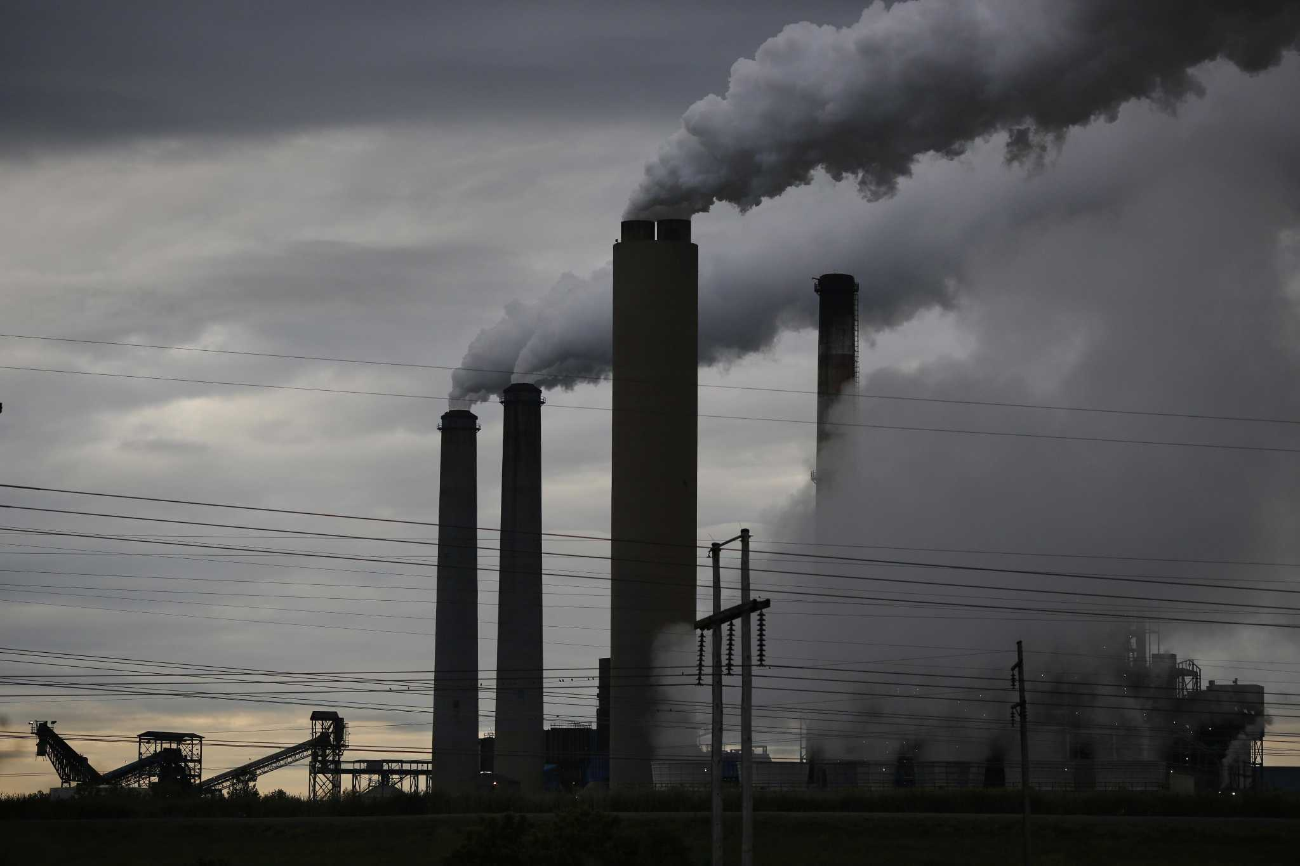

CIS 731 – Final term project
Time series analysis to forecast the evolutionary pattern of coal power production with enhanced renewable energy penetration into the gird at the electricity market in ERCOT region of Texas.
Submitted By:
Kushal Bhalla

Slide 2

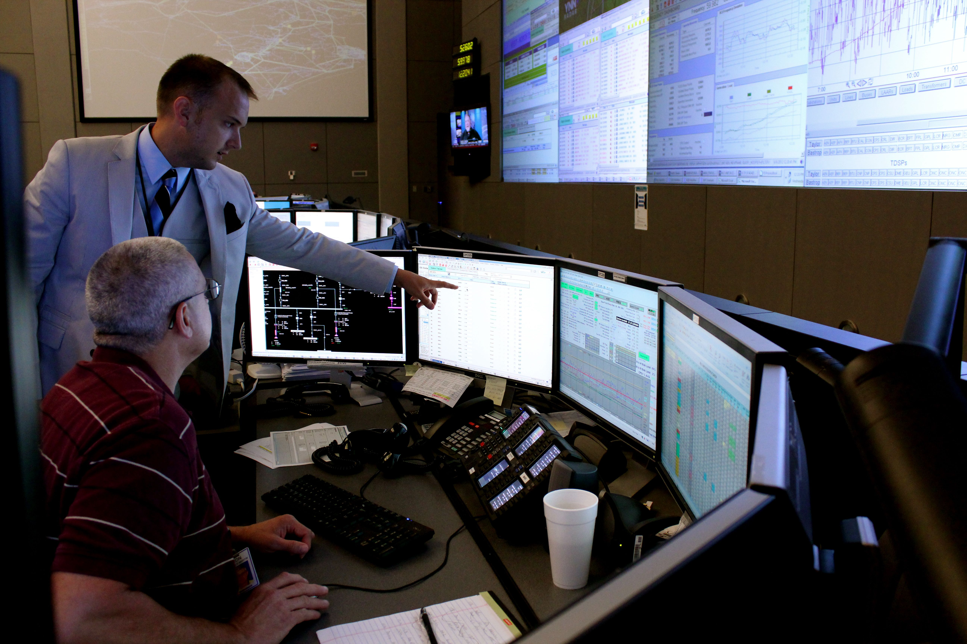
- Membership-based 501(c)(4) nonprofit corporation - Independent system operator for the region - Manages the flow of electric power to 27 million Texas customers - Connects more than 54,100 miles of transmission lines and 1,250 generation units
ERCOT – Electric Reliability Council of Texas

Slide 3
Stages of Analysis
Concept | Description
OBTAIN | From the ERCOT website under, Grid Information – Generation – Fuel Mix. Fifteen minute interval data from 2012 – 2023.
SCRUB | Data was in yearly .xlsx sheets with sub-sheets for different months. Data was converted to time series format for each month, concatenated, and transformed to an hourly data set with 105192 observations.
EXPLORE | Time series visualization and plotting techniques were used to gauge or examine the evolutionary pattern of different series. Different aggregations and averages were used to enhance the exploration.
MODEL | LSTM neural network model was used. Two different hyperparameter specifications were tested. A five fold cross validation was done prior to final training and testing.
INTERPRET | The accuracy of the model forecasts was examined based upon both the internal and the external measures of fit like RMSE, MAE, loss function plot, and residual plot.

Slide 4
EXPLORE
VISUAL EXAMINATION OF DATA

Slide 5
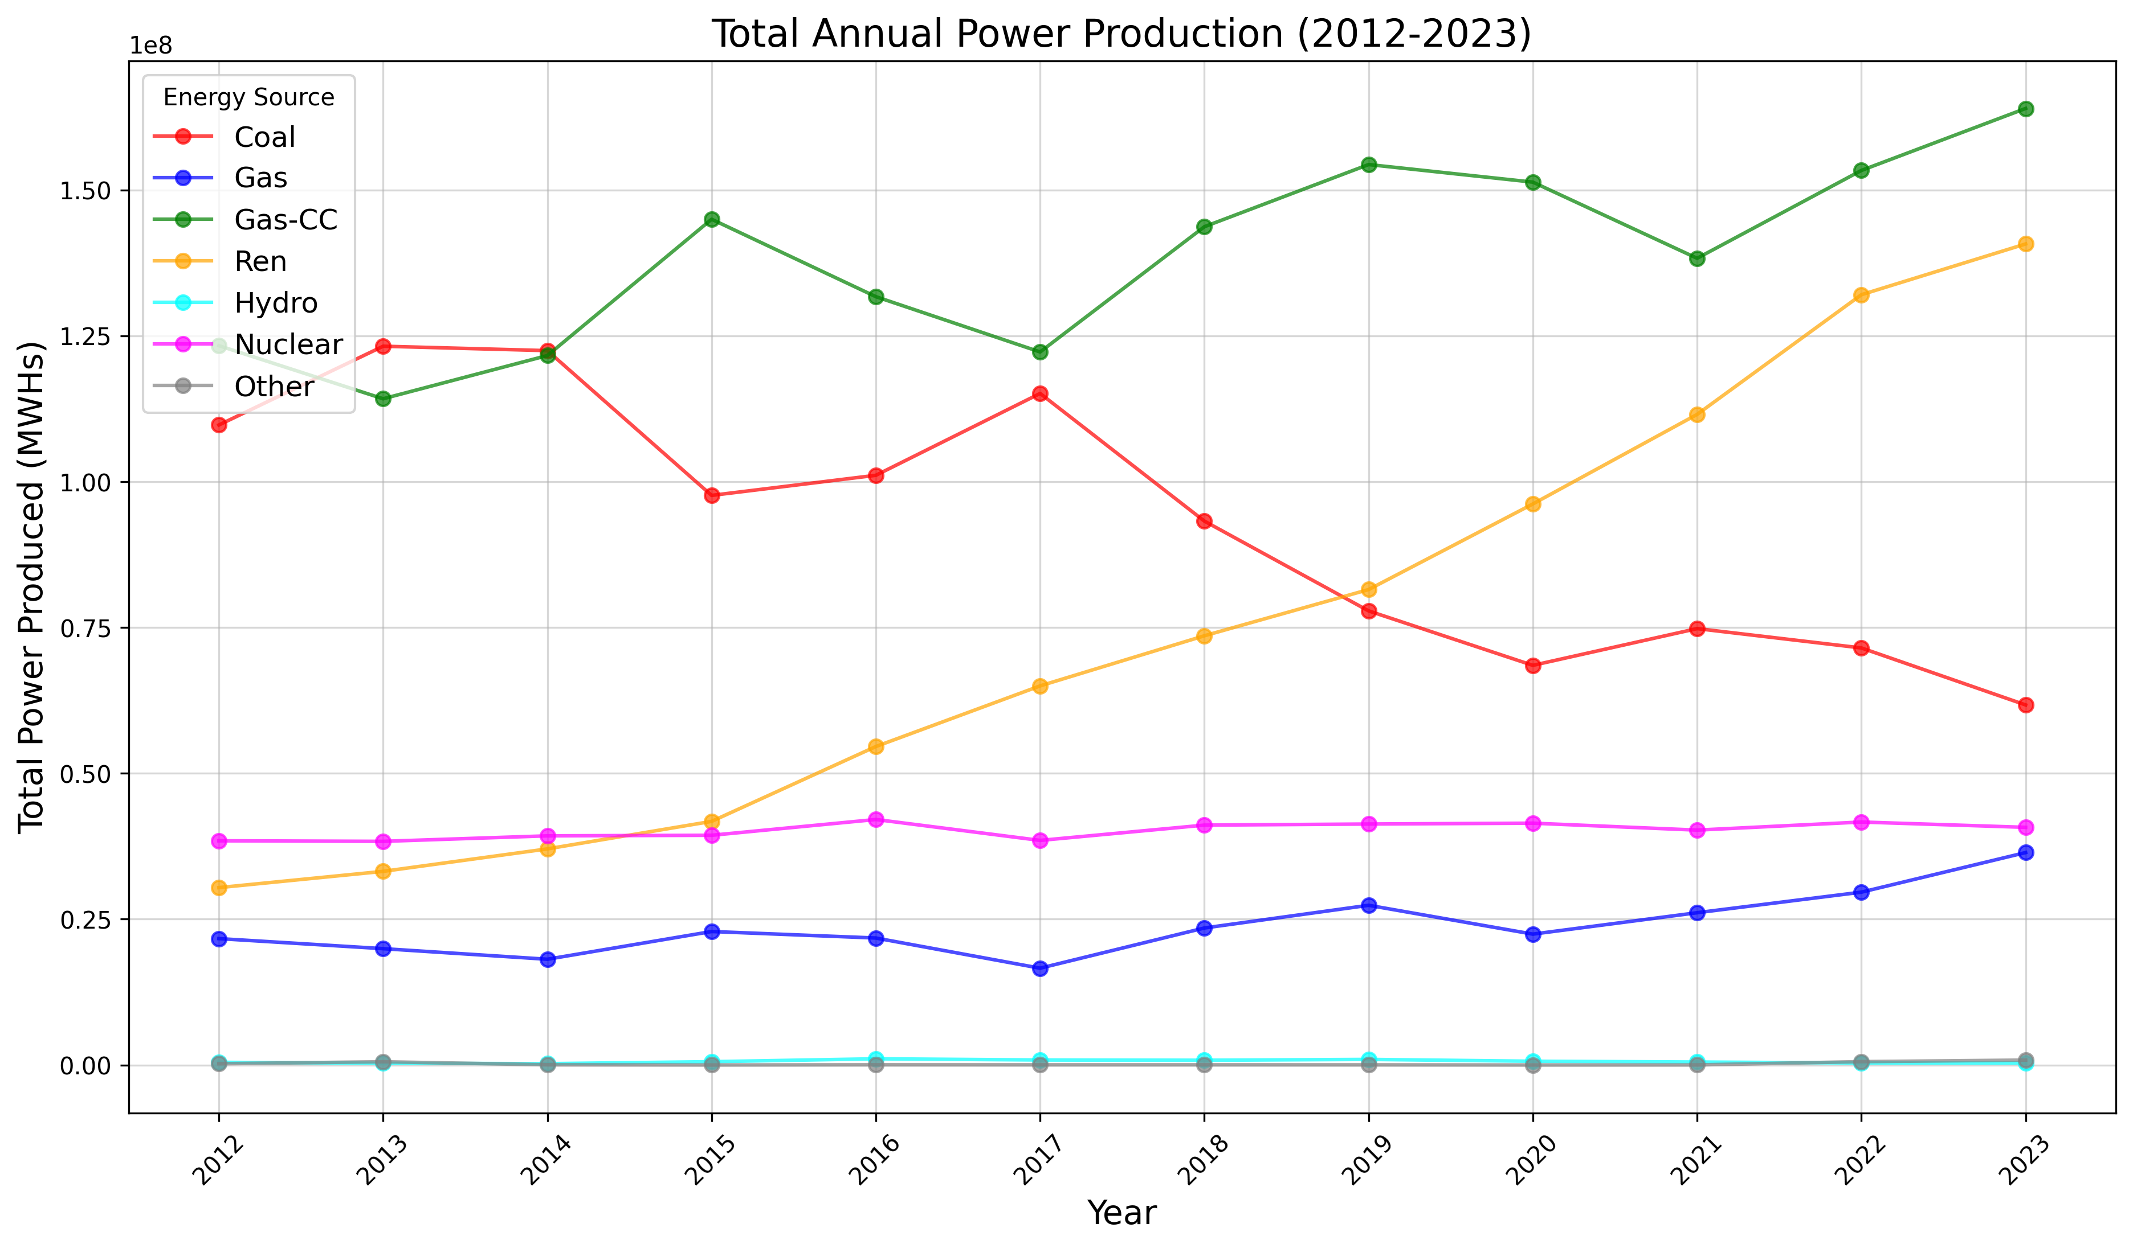
Annual power production for Coal, Gas, Gas-CC, Ren, Hydro, Nuclear, and Other from 2012 - 2023

Slide 6
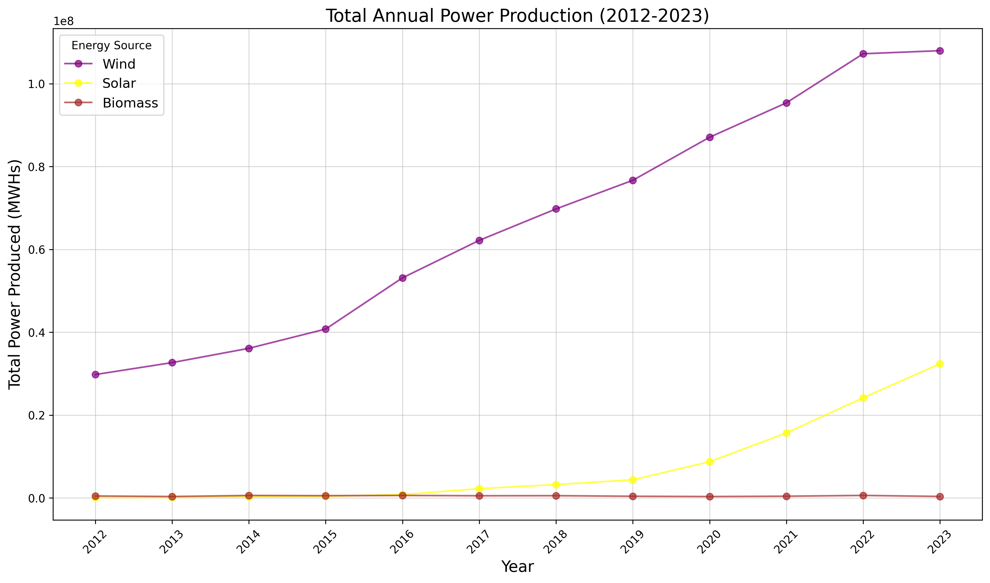
Annual power production for Wind, Solar, and Biomass from 2012 - 2023

Slide 7
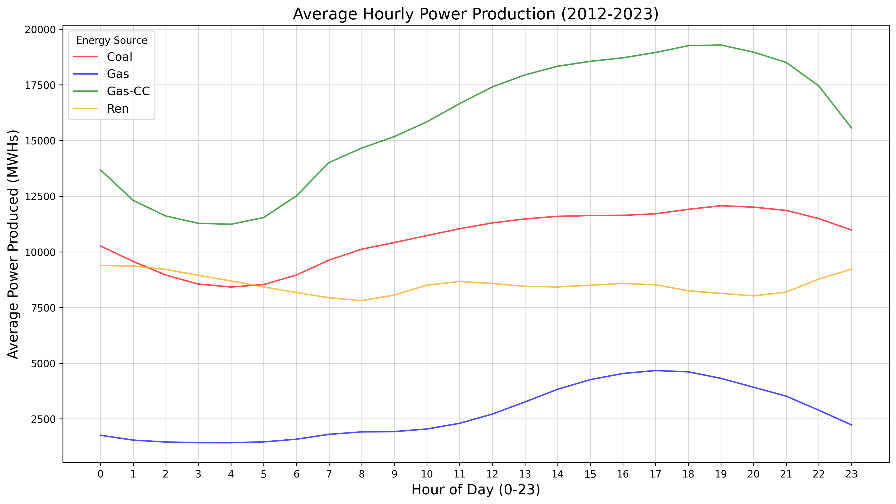
Average hourly power production for Coal, Gas, Gas-CC, and Ren from 2012 - 2023

Slide 8
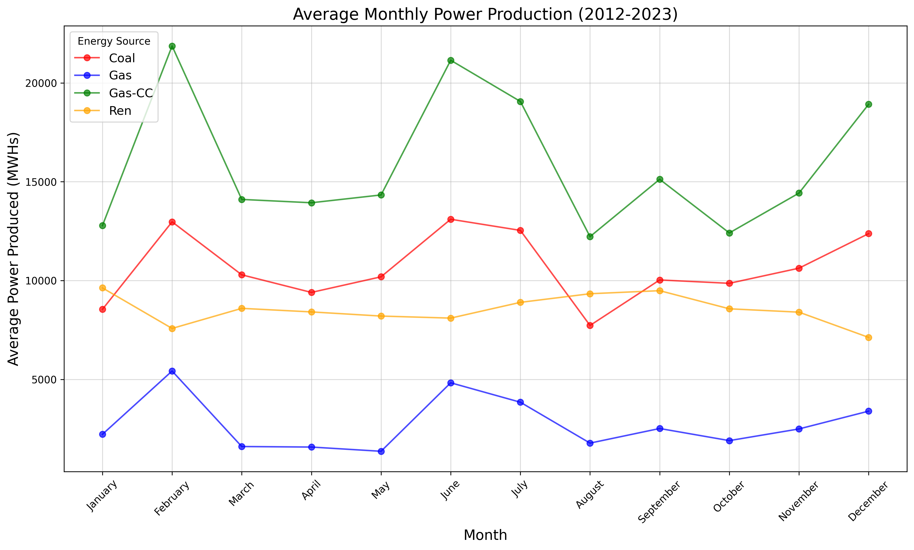
Average monthly power production for Coal, Gas, Gas-CC, and Ren from 2012 - 2023

Slide 9
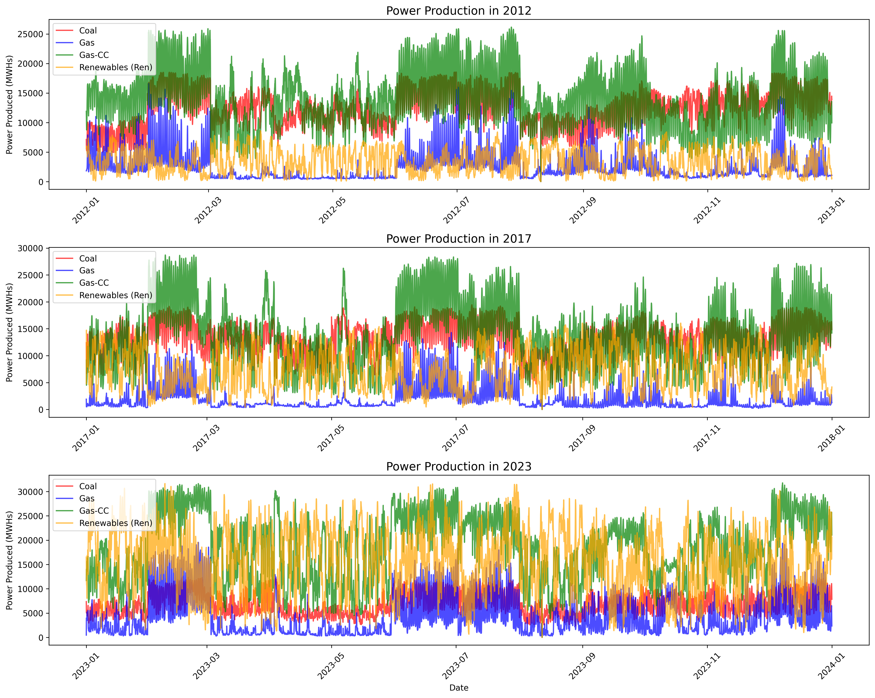
Hourly evolutionary pattern of Coal, Gas, Gas-CC, and Ren for 2012, 2017, and 2023

Slide 10
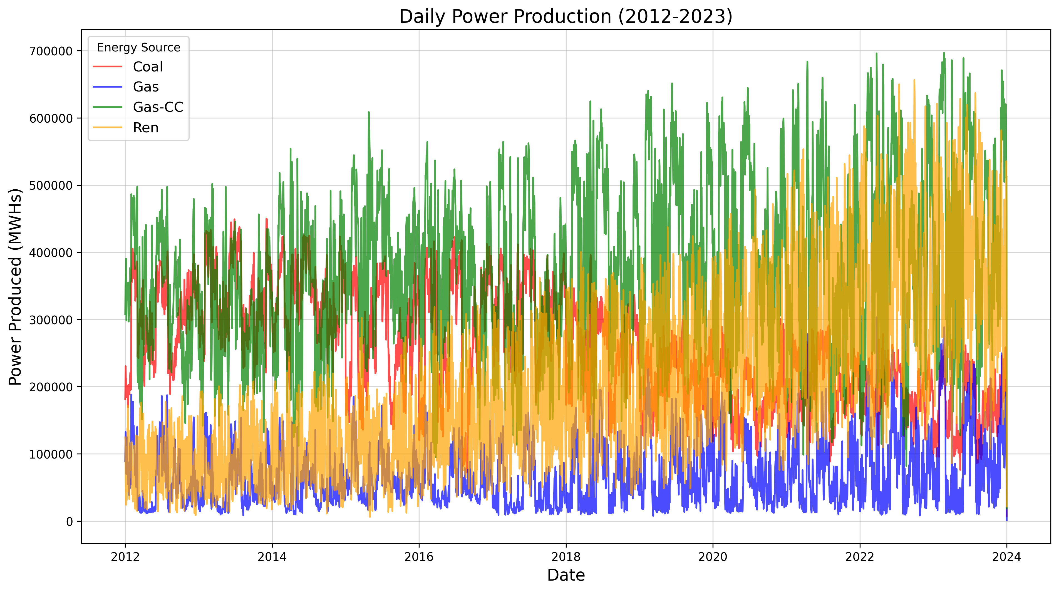
Daily evolutionary pattern of Coal, Gas, Gas-CC, and Ren from 2012 - 2023

Slide 11
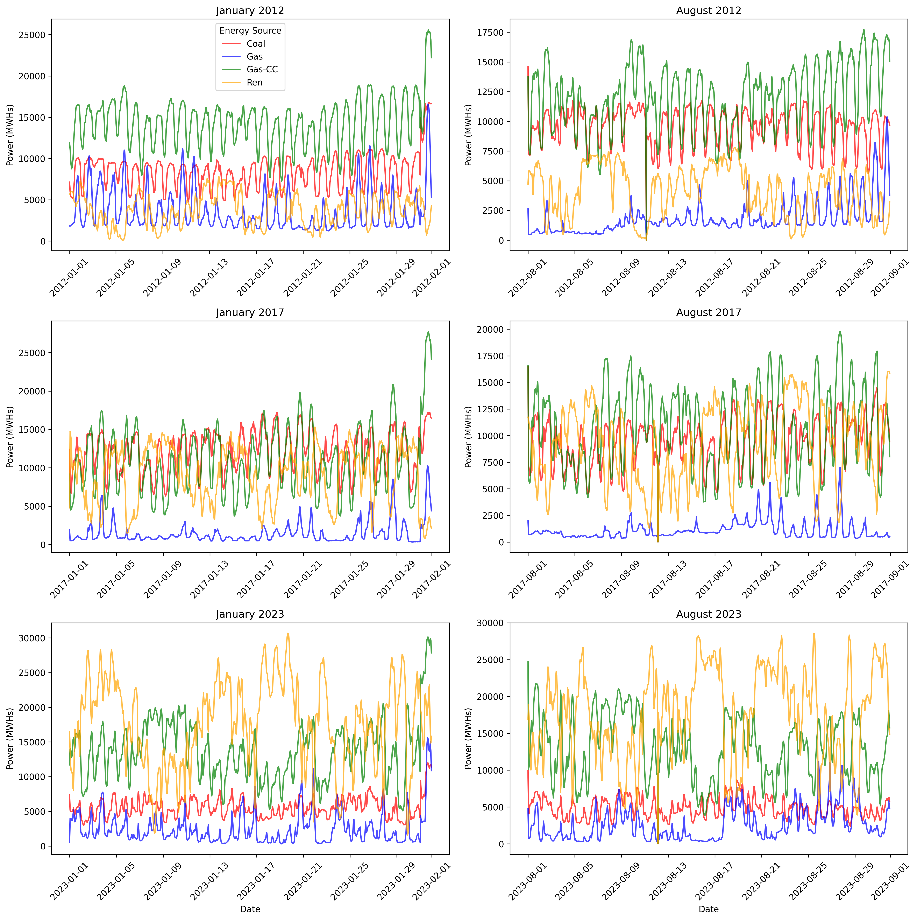
Daily evolutionary pattern of Coal, Gas, Gas-CC, and Ren from 2012 - 2023

Slide 12
MODEL
LSTM neural network model with two different
hyperparameter specifications (tensorflow, keras, sklearn)
VERSION 1
VERSION 2
timesteps = 24
timesteps = 12
Two layers LSTM(50)
One layer LSTM(64)
Dropout(0.2)
Dropout(0.1)
Dense(1)
Dense(1)
Learning rate = 0.001
Learning rate = 0.0005
Patience = 15
Patience = 10
Epochs = 100, batch size = 64
Epochs = 75, batch size = 32

Slide 13
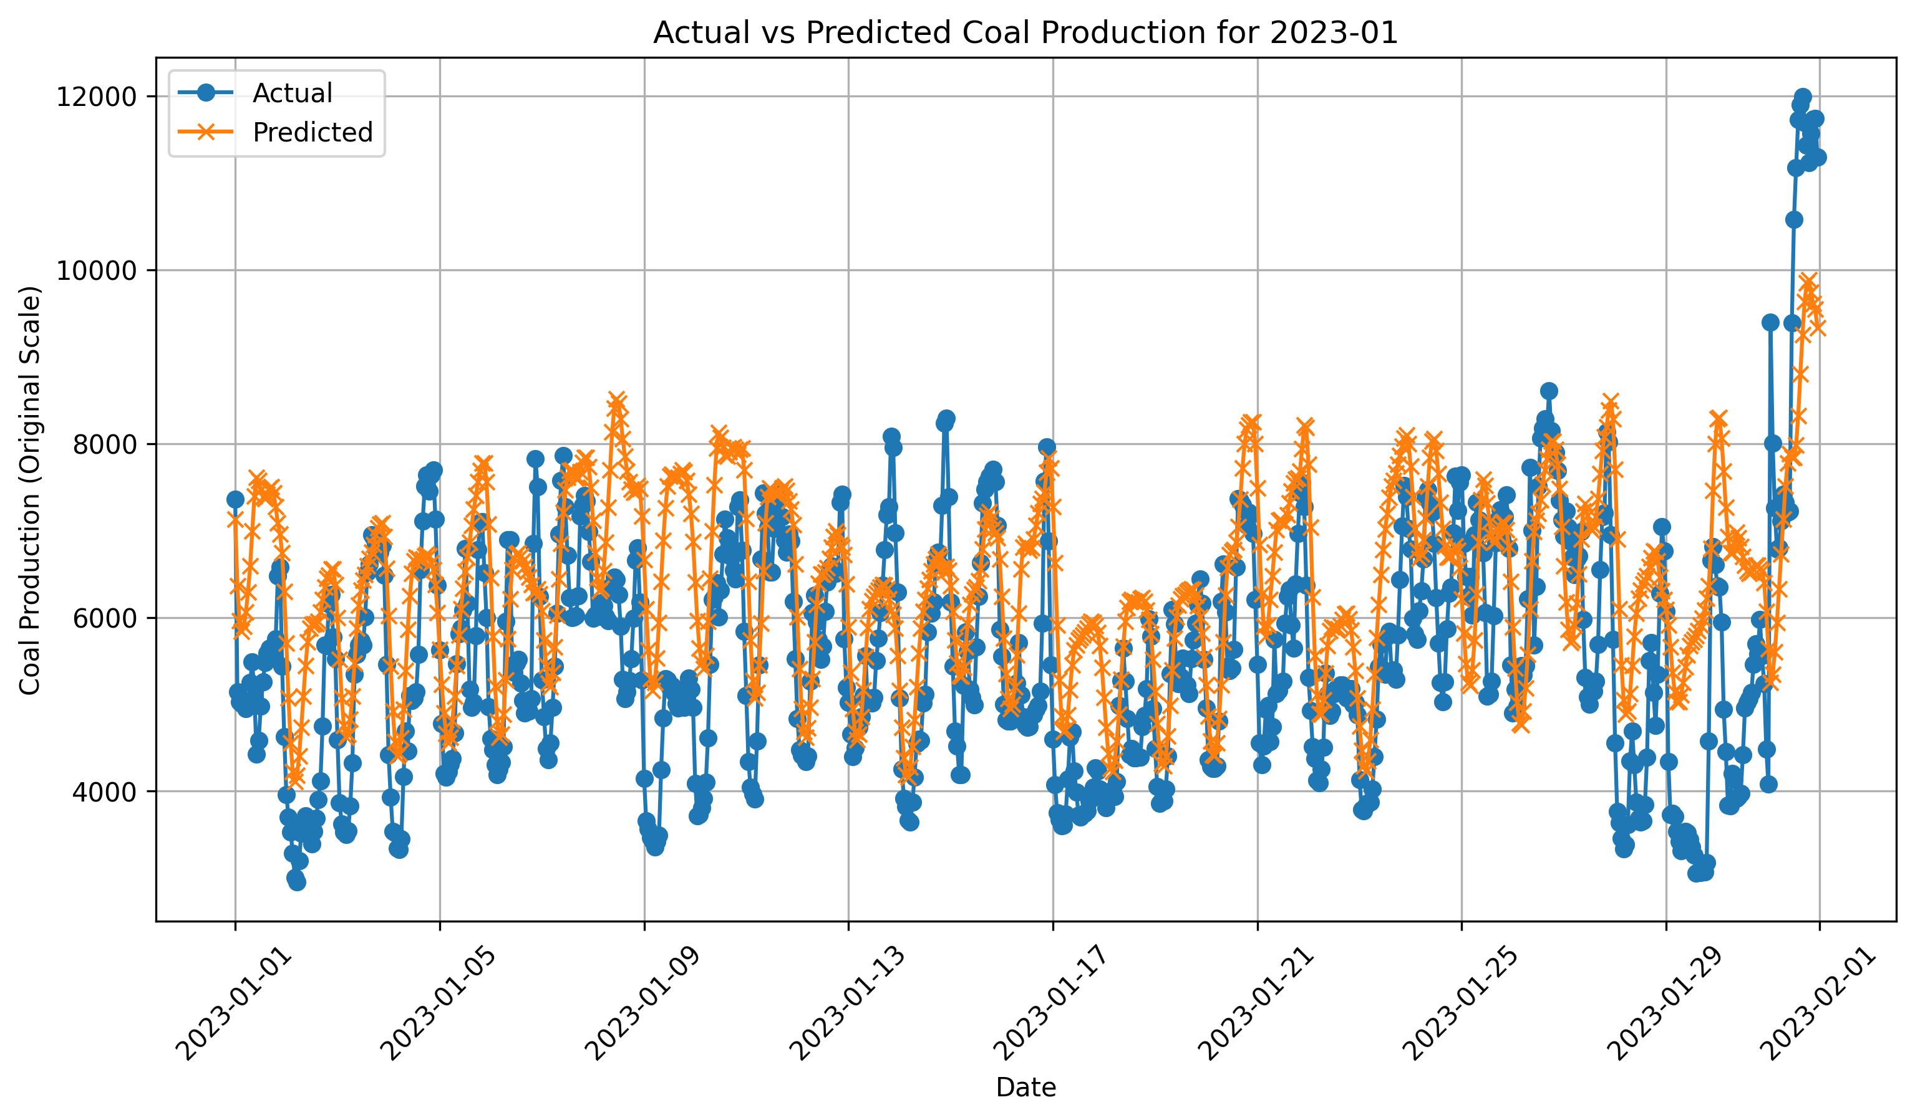
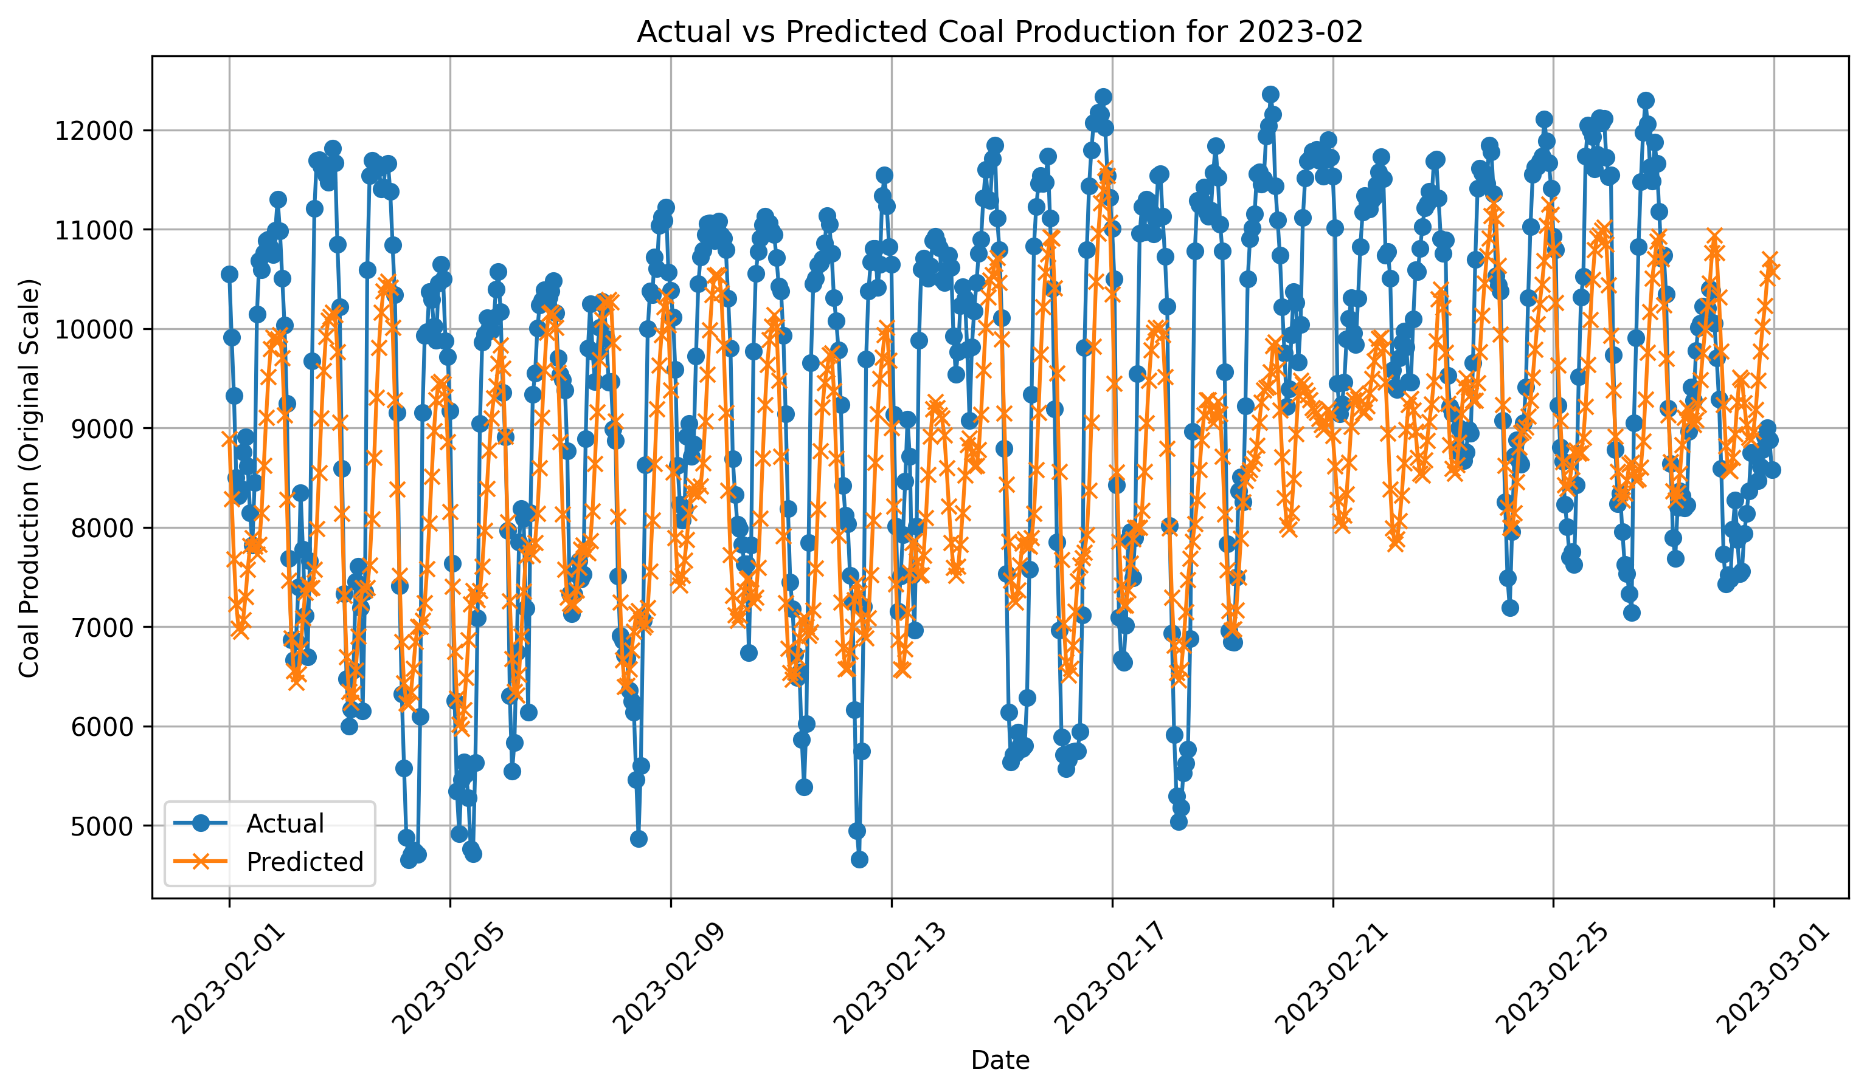
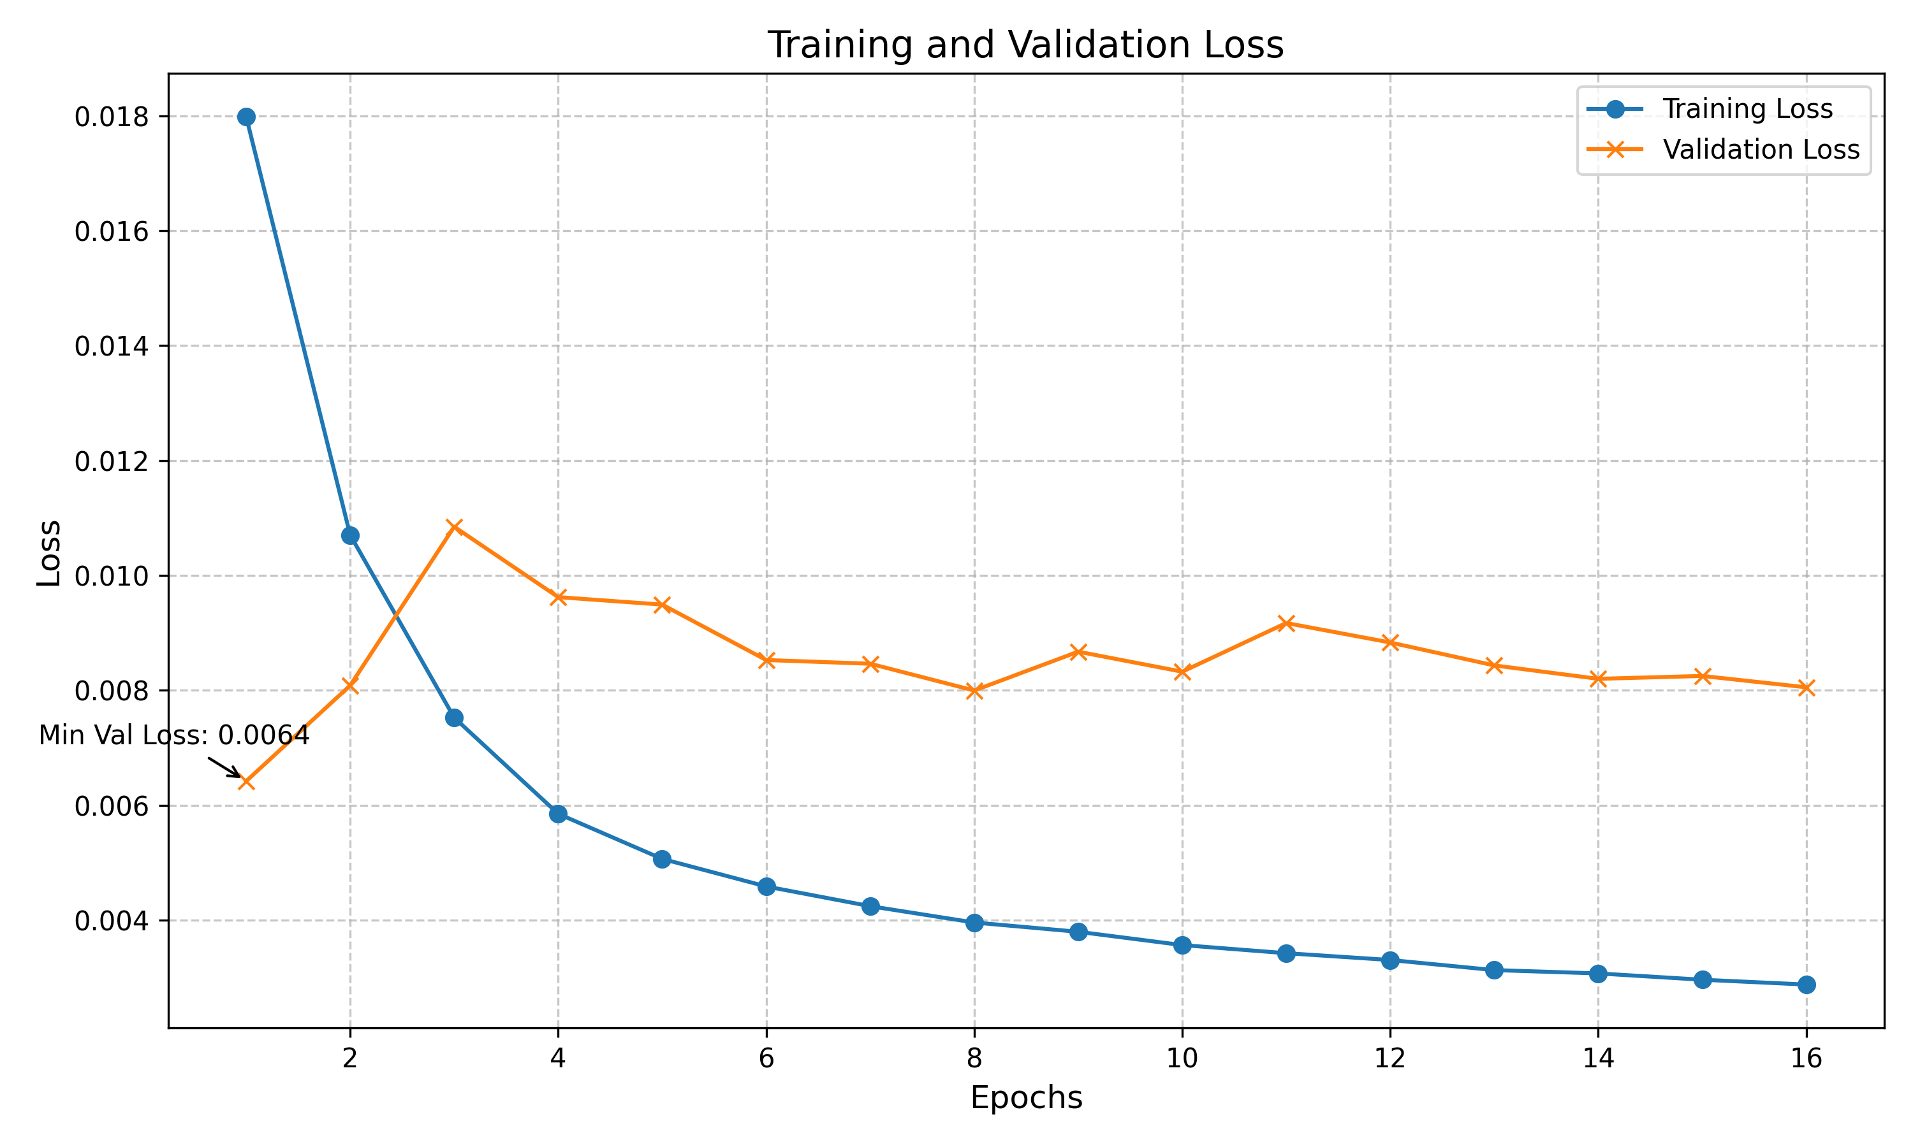
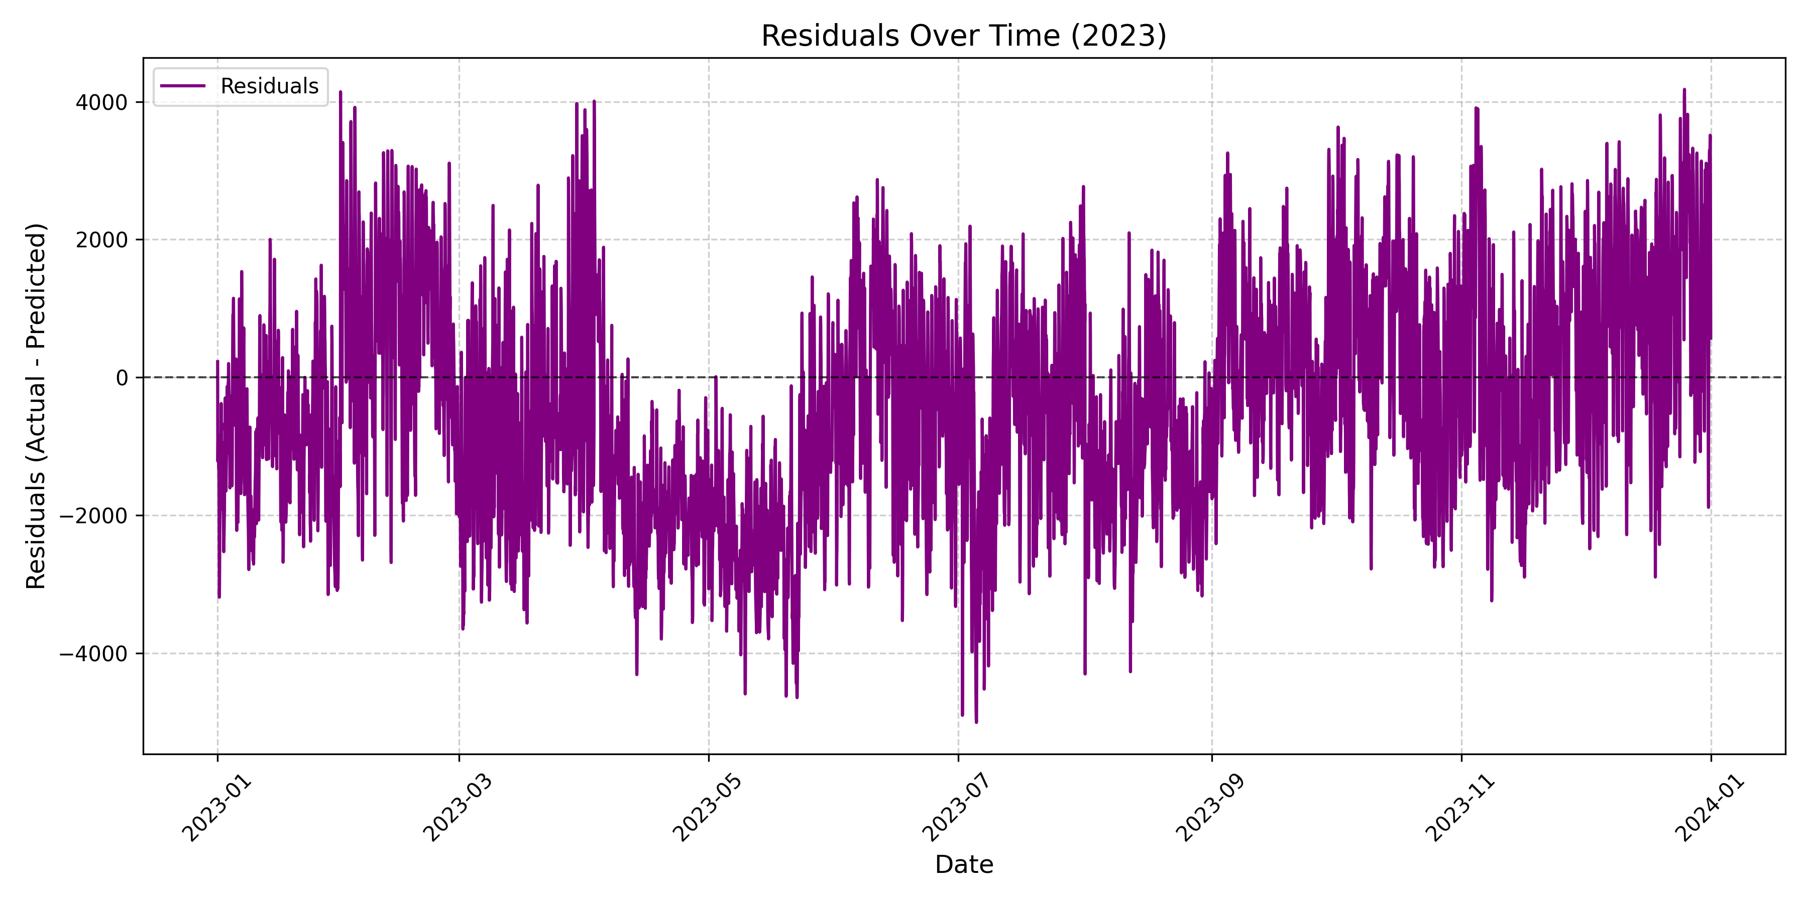
INTERPRETATION / RESULTS (VERSION 1)

Slide 14
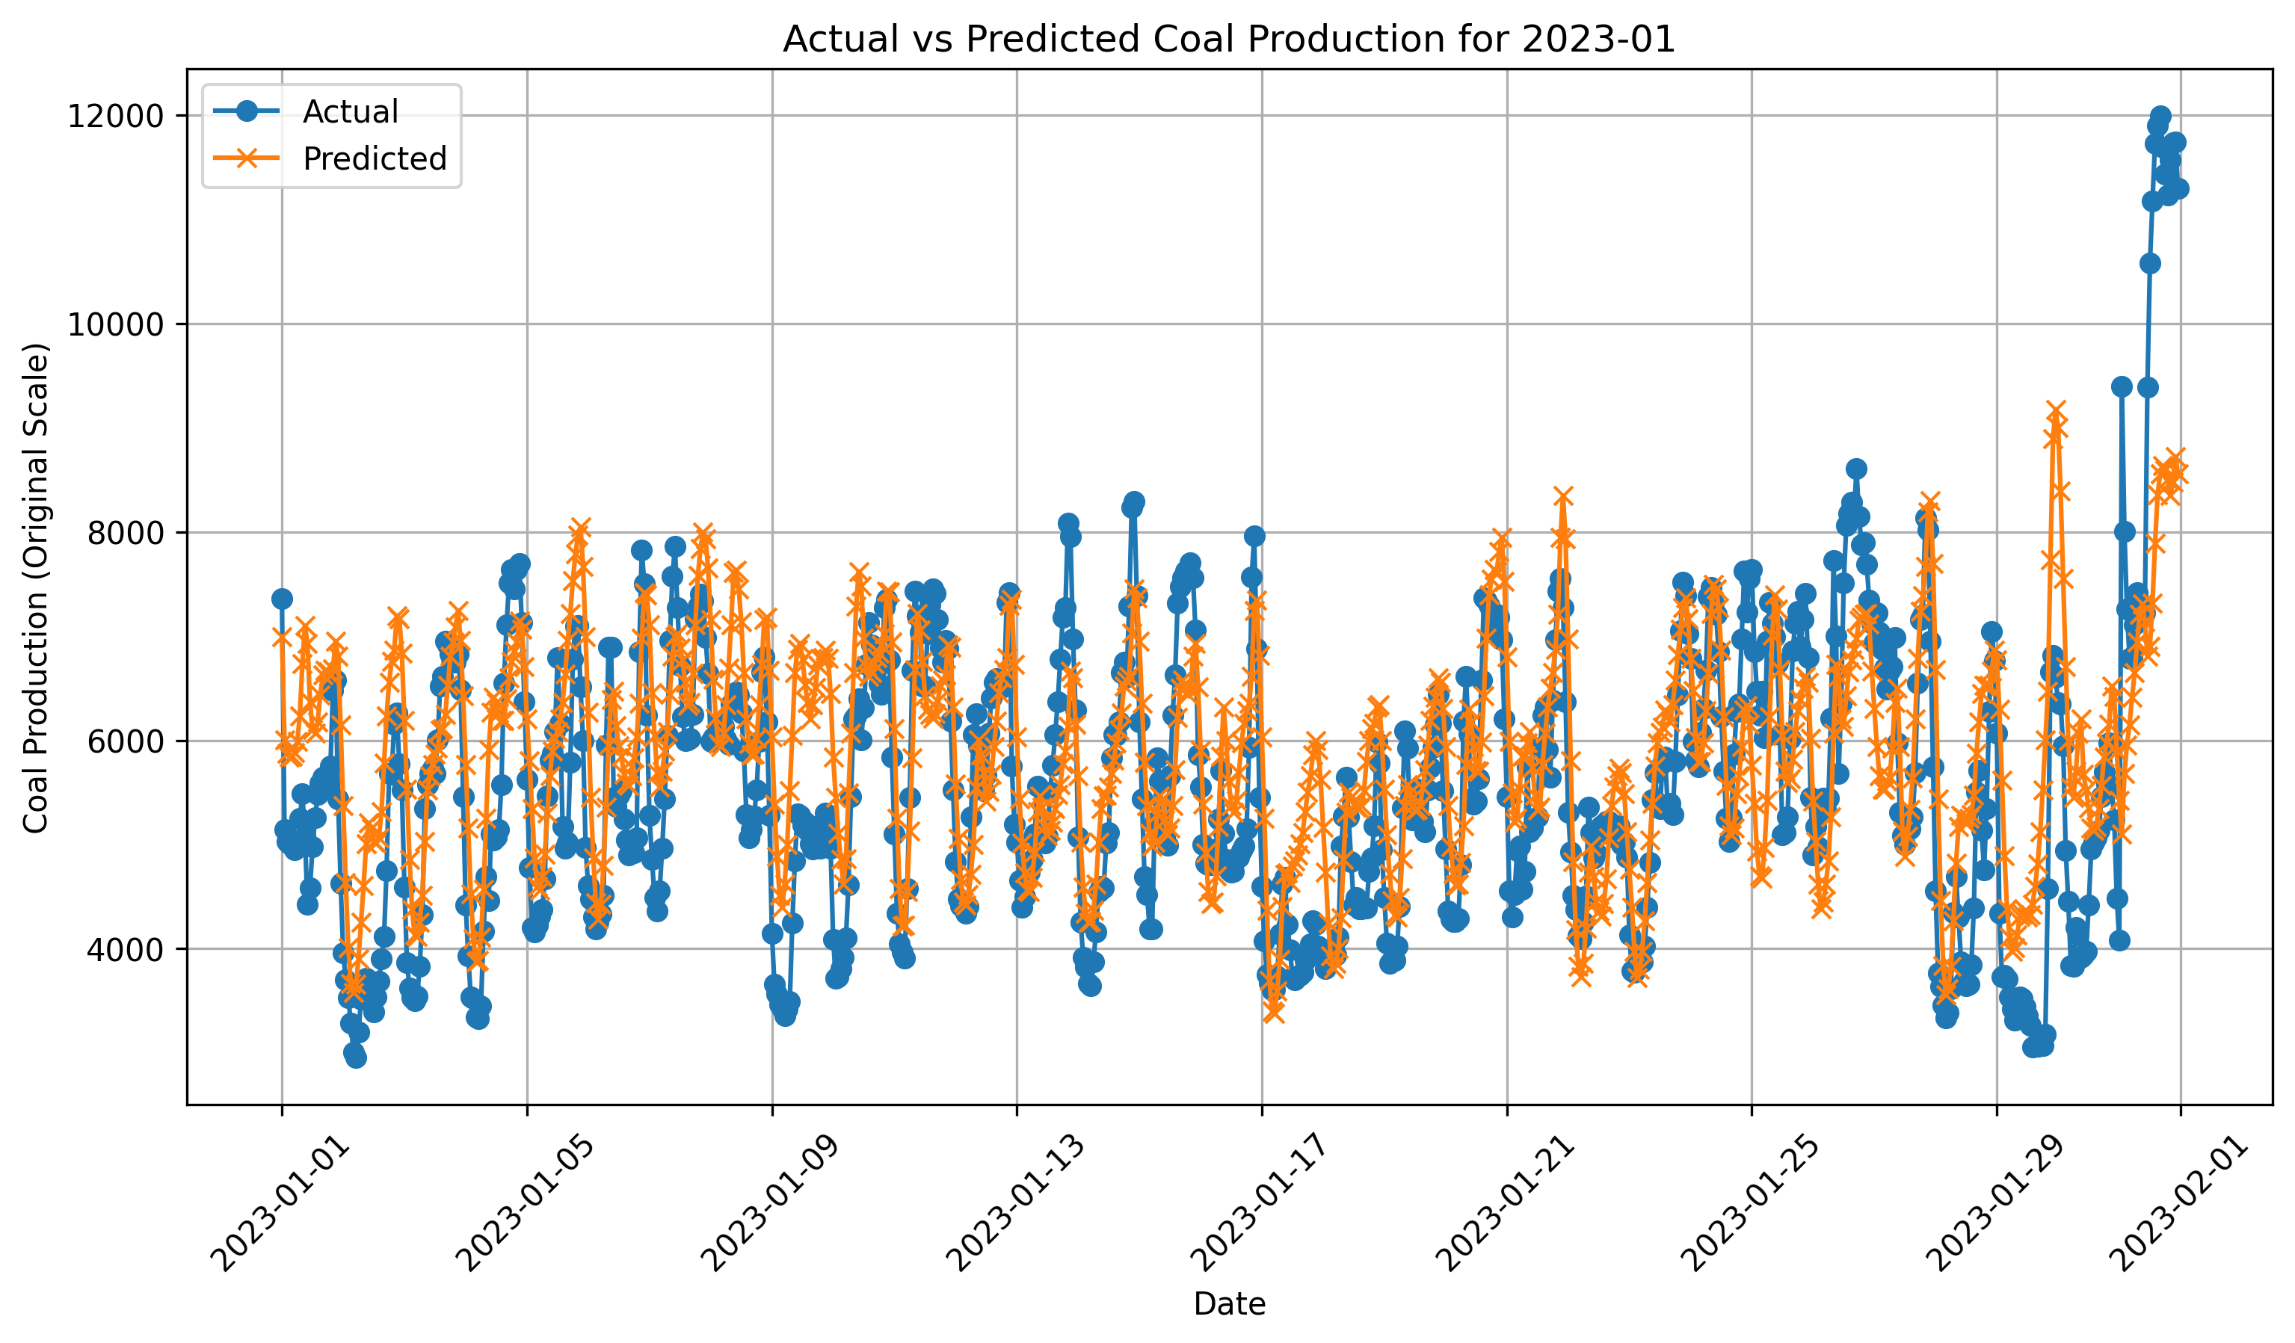
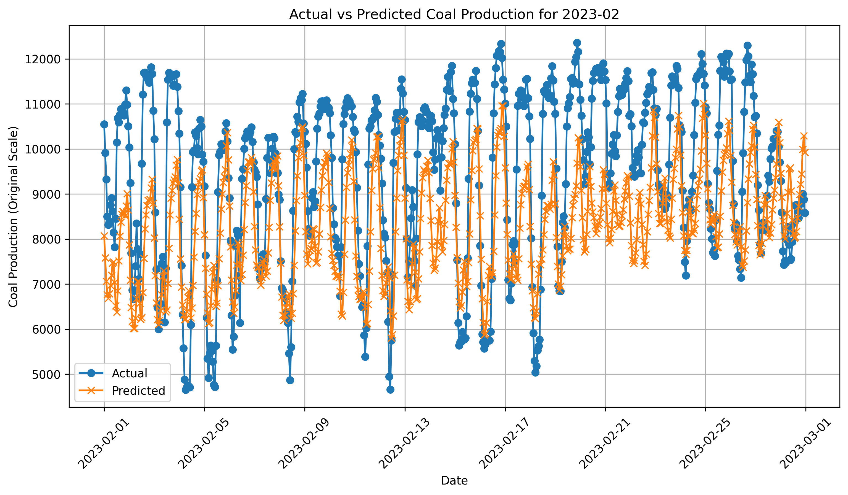
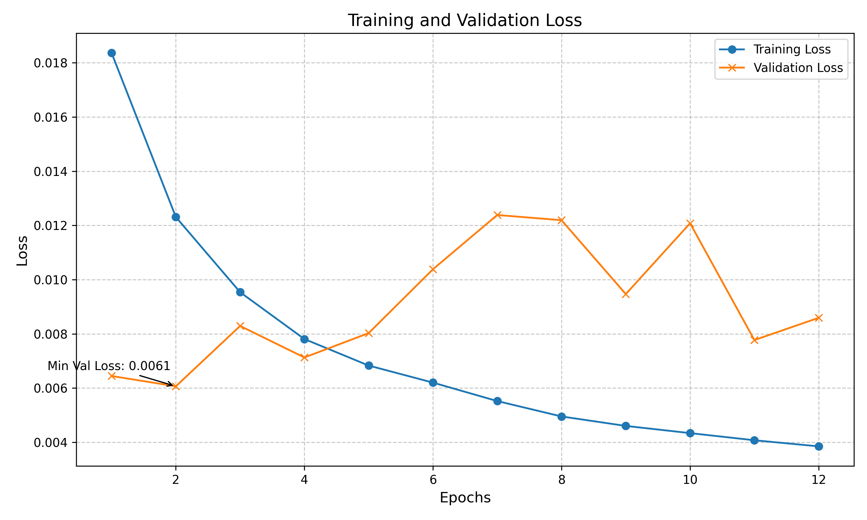
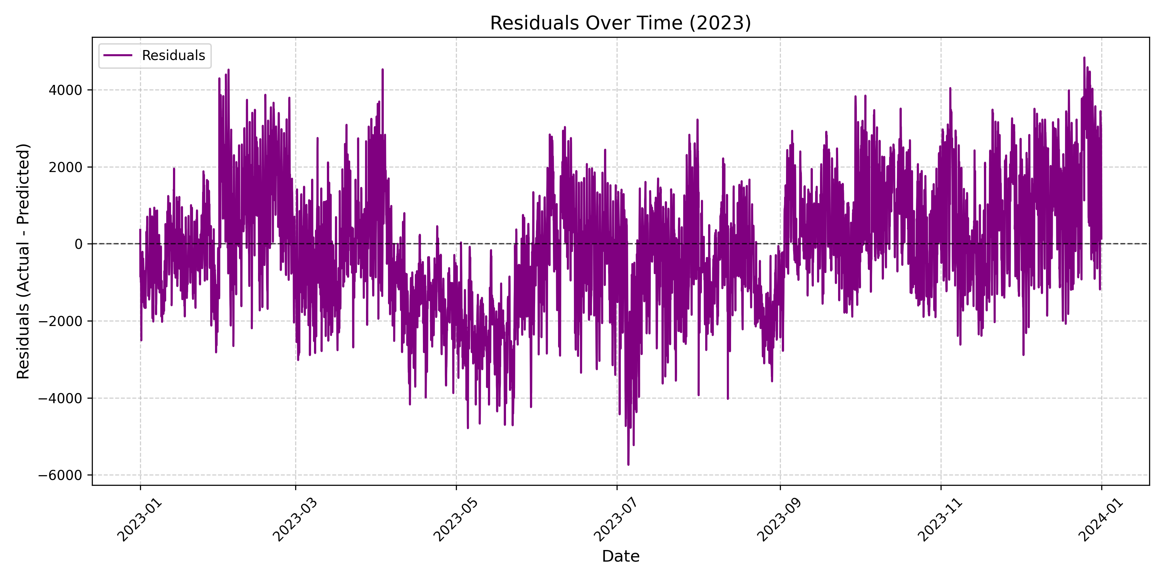
INTERPRETATION / RESULTS (VERSION 2)

Slide 15
INTERPRETATION / RESULTS (Internal/external measures of fit)
VERSION 1
VERSION 2
Validation RMSE for Fold 1: 0.126
Validation RMSE for Fold 1: 0.124
Validation RMSE for Fold 2: 0.117
Validation RMSE for Fold 2: 0.107
Validation RMSE for Fold 3: 0.095
Validation RMSE for Fold 3: 0.086
Validation RMSE for Fold 4: 0.105
Validation RMSE for Fold 4: 0.111
Validation RMSE for Fold 5: 0.063
Validation RMSE for Fold 5: 0.068
Test RMSE: 0.080
Test RMSE: 0.078

Slide 16
INTERPRETATION / RESULTS (External measures of fit – original scale)
VERSION 1
VERSION 2
RMSE: 1615.6593
MAE: 1345.2068
R² (R-Square):0.5274
Explained Variance Score: 0.5563
RMSE: 1570.2027
MAE: 1259.0428
R² (R-Square): 0.5536
Explained Variance Score: 0.5558

Slide 17
MOST CHALLENGING ASPECT. What aspect of data analytics and data science did you find most challenging in completing your term project?
Trying different model specifications and figuring out the optimal set of hyperparameters.
The challenge here was to understand or discern which parameter will have what kind of role
to play while configuring a suitable model. How a high or a low value of that parameter will affect
the model outcomes.
Another aspect was the required GPU/CPU space and memory to execute the model. Since I had an
hourly dataset with 105192 observations, so that created a high computational load.

Slide 18
ASPECT OF MOST LEARNING What aspect of data analytics and data science did you learn the most about in completing your term project?
Data acquisition, preparation, visualization, normalization were key steps in the beginning. In
time series analysis it is necessary to develop a sound understanding of trends (level, slope),
seasonal and cyclic patterns embedded within a time series.
Model selection or model choice is another significant aspect which plays a crucial role
in determining the success of the analytical exercise / research project. Model should provide
satisfactory explanations for all the research objectives.

Slide 19
FUTURE WORK What would be your top priority for future work if you were to continue this project as an independent study or research project?
To possess sufficient computational resources which could handle a large dataset whether
it is GPU or CPU requirements or some other input.
To develop a sound understanding of different model types, parameters, specifications,
and configurations which play a crucial role in preventing from either overfitting or underfitting
a model.

